Slide 1
Reconstruction of Deforming Geometry from Time-Varying Point Clouds 时变点云的变形几何重构

Slide 2
Abstract
In this paper, we describe a system for the reconstruction of deforming geometry from a time sequence of unstructured, noisy point clouds, as produced by recent real-time range scanning devices. Our technique reconstructs both the geometry and dense correspondences over time.
在本文中，我们描述了一种从非结构化，有噪音的点云的时间序列重建变形几何的系统，该系统由最新的实时范围扫描设备产生。我们的技术会随着时间重建几何图形和密集的对应关系。

Slide 3
Using the correspondences, holes due to occlusion are filled in from other frames. Our reconstruction technique is based on a statistical framework: The reconstruction should both match the measured data points and maximize prior probability densities that prefer smoothness, rigid deformation and smooth movements over time.
使用该对应关系，从其他帧填充了由于闭塞引起的孔。我们的重建技术基于一个统计框架：重建既应与测得的数据点匹配，又应使先验的概率密度最大化，这些概率密度在时间上倾向于光滑度，刚性变形和光滑运动。

Slide 4
The optimization procedure consists of an inner loop that optimizes the 4D shape using continuous numerical optimization and an outer loop that infers the discrete 4D topology of the data set using an iterative model assembly algorithm.
优化过程包括一个内循环和一个外循环，内循环使用连续的数值优化来优化4D形状，外循环使用迭代模型组装算法来推断数据集的离散4D拓扑。
We apply the technique to a variety of data sets, demonstrating that the new approach is capable of robustly retrieving animated models with correspondences from data sets suffering from significant noise, outliers and acquisition holes
我们将该技术应用于各种数据集，表明该新方法能够通过遭受严重噪声，奇异值和漏洞的数据集的对应关系，以健壮的方式修复动画模型

Slide 5
Given
unstructured, noisy point clouds produced by recent real-time range scanning devices.
最新的实时范围扫描设备产生的非结构性的，噪音（孔）的点云
Goal
修复点云，去除噪音洞

Slide 6
1.A preprocessing step extracts 3D pieces of geometry in each frame.
2.Adjacent frames are then iteratively merged using a statistical model to align pieces and optimize their shape as well as fill-in holes.
3.an animated triangle mesh is created by a marching cubes based surface extraction algorithm
1.预处理步骤在每个帧中提取3D几何图形。
2.然后使用统计模型迭代合并相邻框架，以对齐零件并优化其形状以及填充孔。
3.通过基于曲面提取合并cubes算法来创建动画三角形网格。

Slide 7
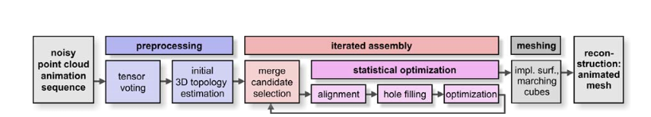
Algorithm Overview

Slide 8
张量投票？？？
预处理点云，以识别行为良好的区域并去除异常值：
为了提取光滑的，可能弯曲的曲面，我们采用张量投票，这是一种强大的特征提取技术，此过程还可以删除孤立的异常值

Slide 9
Initial Estimation of Recoverable 3D Topology 可恢复3D拓扑的初始估计
The first step is a preprocessing step that extracts areas where the 3D topology Ts of the data is obvious from a single frame. Later, these potentially disconnected pieces will be stitched together to assemble the global topology, assuming that it will become obvious over several frames.
第一步是预处理步骤，该步骤从单个帧中提取出数据的3D拓扑T_{s}很明显？？的区域。以后，假设这些全局断开连接在多个帧上都变得很明显，它们将被缝合在一起以组装全局连接拓扑。

Slide 10
Discretization:离散化
To simplify the formulation, we define the probabilistic model directly in the discretized domain. Following [STT93, JWB*06], we choose a set of oriented particles (surfels) s_{i} (t) , i = 1…n_{s} , t = 1…n_{t} as discretization.
为了简化表述，我们直接在离散化域中定义概率模型。 [STT93，JWB * 06]之后，我们选择一组定向粒子（surfels）s_{i}（t），i = 1…n_{s}，t = 1…n_{t}作为离散化。
Particles with the same index i are always in correspondence. i.e. they form a trajectory over time t that stays on the same physical piece of surface (i.e., the number of particles is the same for every frame).
具有相同索引i的粒子总是对应的。 也就是说，它们形成的轨迹随时间t停留在同一块物理表面上（即，每帧的粒子数量相同）。

Slide 11
The trajectories are connected by a graph T S that describes their topology: An edge e_{i,j} is contained in T_{s} if the geodesic distance between the trajectories is smaller than a user defined constant ε top .
轨迹通过描述其拓扑的图形T_{s}连接：如果轨迹之间的测地线距离小于用户定义的常数εtop，则边缘e_{i,j}包含在T_{s}中。
εtop = c· ε_{sampl}设置为c =2， ε_{sampl}采样距离（用户定）
我们将具有连接图T_{s}的一组surfel轨迹称为4D拓扑（+时间序列）。我们用N_{T}（s）表示作为surfel的拓扑邻居的surfel集。

Slide 12
此步骤可能仍然会出错：在某些情况下，例如张口，无法从某些框架可靠地估计拓扑。
After adjusting rigidity weights and maximum edge length change tolerance manually, our algorithm is able to compute the correct topology.
手动调整刚度权重和最大边长变化容限后，我们的算法能够计算出正确的拓扑。

Slide 13
Geometric Alignment
对齐

Slide 14
The first step in the merging process is to align two frames at adjacent times such that corresponding pieces of the surface come to rest at the same spatial positions. This alignment will then be used subsequently to form topological connections.
合并过程的第一步是在相邻时间对齐两个框架，以使表面的相应部分停在相同的空间位置。然后，将使用此对齐方式来形成拓扑连接。

Slide 15
We employ the statistical optimization procedure to obtain a variant of non-rigid ICP [HTB03]:
我们采用统计优化程序来获得非刚性ICP [HTB03]的变体
We form an auxiliary scene with two frames: The first frame is constant and set to S (t_{left} ) . The second frame contains the unknown alignment to be optimized; the variables are also initialized with S (t_{left}) as starting position.
我们形成具有两个帧的辅助场景：第一帧为常数，并设置为S (t_{left}) 。第二帧包含要优化的未知对齐方式；变量也以S (t_{left}) 作为起始位置进行初始化
The data points in the second frame are set to S (t_{right}) in order to attract the aligned frame to the configuration in the following frame. We then perform continuous optimization on the second frame using data matching and rigidity potentials only, until convergence.
第二帧中的数据点设置为S（右），以将对齐的帧吸引到下一帧中的配置。然后，我们仅使用数据匹配和刚度潜力对第二帧执行连续优化，直到收敛。

Slide 16
We employ a Bayesian approach to surface reconstruction [DTB06, JWB*06]: Given a data set D, we compute the posterior probability Pr(S|D) for a candidate reconstruction S as:
我们采用贝叶斯方法进行表面重建[DTB06，JWB * 06]：给定数据集D，我们计算后验概率Pr（S | D） 对于候选重建S为：
Pr(S|D) ~ Pr(D|S) Pr(S)
To simplify computations, the optimization is done in log space, leading to an objective function
为了简化计算，优化在对数空间中完成，从而产生目标函数
– log Pr(S|D) ~ – log Pr(D|S) – log Pr(S)

Slide 17
The likelihood term Pr(D|S) models how well the data is explained by the candidate reconstruction and the prior Pr(S) quantifies how likely the reconstruction itself is a priori, not considering the data.
似然项Pr（D | S）通过候选重建设对数据的解释程度进行建模，而先验Pr（S）量化重构本身是先验的可能性，而不考虑数据。

Slide 18


Slide 19
Likelihood (Data Attraction)
似然项

Slide 20
Likelihood (Data Attraction):
The likelihood term E_{match} (D,S) models the negative log-probability that data D has originated from the reconstructed surfaces S. We assume that all data points have been created independently from each other, according to a noise probability density noise ^{(t)} (x, y), x ∈ S, y ∈ R³ .
似然性项E_{match} (D,S)对数据D源自重构曲面S的负对数概率进行建模。我们假设，根据所有数据点彼此独立的噪声概率密度
noise ^{(t)} (x, y), x ∈ S, y ∈ R³ .

Slide 21
Assuming uniform sampling probability (i.e., having no prior knowledge about how densely different portions have been sampled) and denoting the reconstructed surface at time t by S (t) , the probability density p(D|S) is then given by the product of all
假设采样概率均匀（即不具有关于如何对不同部分进行密集采样的先验知识），并在时间t处用S（t）表示重构表面，则概率密度p（D | S）由下式的乘积给出：

Slide 22


Slide 23
选择高斯分布
The negative log-likelihood is then given by the squared distance function [PH03], scaled according to the variance of the Gaussian noise model in normal direction
然后通过平方距离函数[PH03]给出负对数似然率，该距离函数根据高斯噪声模型在法线方向上的方差进行缩放
这近似混合了高斯分布和均匀分布

Slide 24
Spatial Smoothness (Noise Removal)空间光滑度（去噪）：
为了评估表面的光滑度，我们为每个surfel s_{i} ^{(t)}分配法线向量n(s_{i} ^{(t)} )
The normals are latent variables; they are not measured directly but only inferred due to the priors. The objective function (negative log likelihood) prefers normals and point positions so that neighboring points are located close to the plane (Eq. 6). In addition, neighboring normals should be similar (Eq. 7):
法线是潜在变量。 它们不是直接测量的，而是仅根据先验推断得出。 目标函数（负对数似然）更喜欢法线和点位置，以便相邻点位于靠近平面的位置（等式6）。 此外，相邻的法线应该相似（等式7）：

Slide 25
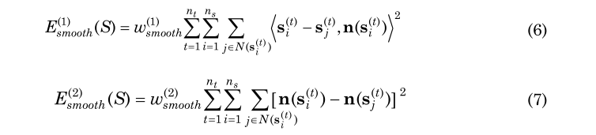

Slide 26
The overall objective function is the sum of these two functions. In addition to the smoothness terms, we also employ a Laplacian potential
总体目标函数是这两个函数的总和。 除了光滑度术语，我们还利用拉普拉斯势
which attracts surfels to the centroid of their neighbors. This leads to a uniform distribution of surfels on the sampled surface. As this is only an additional regularization, we use only a small weight, typically 10% of the position weigh
这将surfel吸引到邻居的centroid。这将导致surfels在采样表面上的均匀分布。由于这只是附加的正则化，因此我们仅使用较小的权重，通常是位置权重的10％。

Slide 27
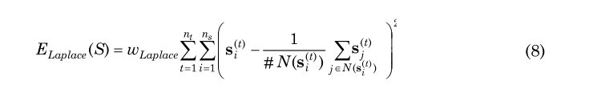

Slide 28
Spatio-Temporal Smoothness (Rigidity)
时空光滑度（刚性）

Slide 29
Spatio-Temporal Smoothness (Rigidity)时空光滑度（刚性）:
The transformation is modeled as a local rigid transformation. We use A_{i}^{(t)} to denote the corresponding, orthonormal 3 × 3 rotation matrix.
该局部变换是一个潜在变量，可以使用先验间接地重构。 将该变换建模为局部刚性变换。 我们使用A_{i}^{(t)}表示对应的正交3×3旋转矩阵。
We then employ the following objective function:
然后，我们采用以下目标函数：

Slide 30


Slide 31
Temporal Smoothness (Acceleration Prior)

Slide 32

Temporal Smoothness (Acceleration Prior)

Slide 33
Numerical Optimization数值优化：
The sum of the log probabilities of the described probability densities yields a non-linear least-squares problem, which we solve using numerical optimization..
所描述的概率密度的对数概率之和产生一个非线性最小二乘问题，我们使用数值优化来解决。

Slide 34
Several problems have to be dealt with: First, we need a reasonable starting value as the log likelihood might have multiple local extrema
必须解决几个问题：首先，由于对数似然可能具有多个局部极值，因此我们需要一个合理的起始值

Slide 35
we need an unconstraint representation for rotation matrices: We parameterize the A_{i}^{(t)} by 3 dimensional rotation vectors c_{i}^{(t)} : Their orientation defines the rotation axis and their length the angle of rotation.
我们需要旋转矩阵的无约束表示形式：我们通过3维旋转向量c_{i}^{(t)}来对A_{i}^{(t)}进行参数化：它们的方向定义了旋转轴，其长度定义了旋转角度。
We can compute the rotation matrix as matrix exponent of the skew symmetric matrix C_{×i} (t) which describes the linear operation of taking the cross product with the vector c_{i}^{(t)} :
我们可以将旋转矩阵计算为倾斜对称矩阵C_{×i} (t)的矩阵指数，该矩阵描述将叉积与向量c_{i}^{(t)}进行线性运算的方法：

Slide 36
During the optimization, we use the first order Taylor expansion (12) of the matrix exponential to parameterize the transformations in the local neighborhood of the current estimate. As in the case of tangential normal parameterizations, a valid orthonormal rotation matrix and a new local parameterization are computed after each step. Initial estimates are computed using the technique of [Hor87].
在优化过程中，我们使用矩阵指数的一阶泰勒展开式（12）对当前估算值的局部邻域中的变换进行参数化。与切向法线参数化的情况一样，在每个步骤之后都将计算有效的正交法线旋转矩阵和新的局部参数化。使用[Hor87]的技术计算初始估计。

Slide 37
A second issue is parameterization: While the surfel position is unconstraint, the optimization of normals and rotation matrices is a constraint optimization problem.
第二个问题是参数化：当surfel位置不受约束时，法线和旋转矩阵的优化是一个约束优化问题。
In order to avoid the difficulties of dealing with constraint non-linear optimization, we employ the parameterization approach of [HP04]: We describe changes to the normal by offset vectors in the tangent plane spanned by vectors tu , tv
为了避免处理约束非线性优化的困难，我们采用了[HP04]的参数化方法：我们描述了由向量tu，tv跨越的切线中的偏移向量对法线的变化。

Slide 38
and solve for the parameters u, v during the optimization. Then we recompute the normals and the local parameterization for the next step of the non-linear optimization. Using this parameterization, the normals might only grow, which enlarges the objective function, thus avoiding degenerate solutions (as for unconstrained normals).
并在优化过程中求解参数u，v。 然后，我们为非线性优化的下一步重新计算法线和局部参数化。 使用此参数化，法线可能只会增长，从而扩大目标函数，从而避免退化的解（对于无约束法线）。 初始法线使用

Slide 39
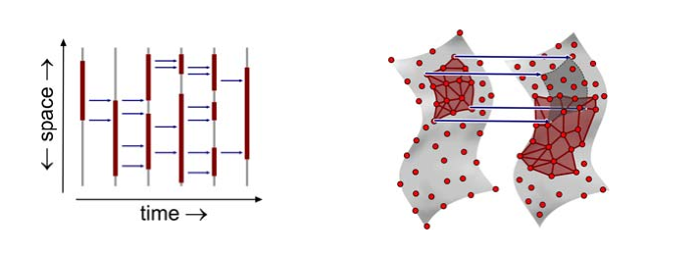
(a) Merging partially known topology (schematic) (b) Pieces of known 3D topology (red) are merged
（a）合并部分已知的拓扑（示意图）（b）合并部分已知的3D拓扑（红色）

Slide 40
Topological Stitching拓扑拼接
Having aligned the two frames, we have to stitch together their topology. In order to do so, we start from scratch and just connect every surfel to all of its neighbors within distance ε top in the aligned configuration.
将两个框架对齐后，我们必须将它们的拓扑拼接在一起。 为此，我们从头开始，仅将每个surfel连接到对齐配置中距离εtop以内的所有相邻surfel。

Slide 41
Hole Filling孔填充：
The frames directly involved in the alignment have already been filled in with aligned data
与对齐直接相关的帧已经用对齐的数据填充

Slide 42
Resampling重采样
The next step is to resample the surfel graph in order to keep the discretization density (and thus the computational costs) constant.
下一步是对surfel图进行重采样，以保持离散化密度（从而保持计算成本）恒定。

Slide 43
Global Optimization and the Urshape:全局优化和Urshape：
we perform a global optimization of the complete merged range of frames on all surfels, again minimizing the previously derived statistical energy function.
我们对所有surf上的帧的完整合并范围​​执行全局优化，再次最小化先前导出的统计能量函数。

Slide 44
Iteration迭代:
The whole merging procedure (alignment, hole filling, stitching, resampling and global optimization) is iterated in a binary scheme until all frames of the animation are merged
迭代整个合并过程（对齐，孔填充，缝合，重采样和全局优化），直到合并动画的所有帧为止

Slide 45
Meshing网格划分
The result of the reconstruction is a graph of trajectories sampled with oriented surfels. From this representation, we create the final animated mesh.
重建的结果是用定向surfel采样的轨迹图。根据此表示，我们创建最终的动画网格。

Slide 46
实验

